Slide 1
Intro to Machine Learning
Dr. Oybek Eraliev,
Department of Computer Engineering
Inha University In Tashkent.
Email: oybekeraliev7@gmail.com

Slide 2
Content
What is Machine Learning?
Supervised Learning
Unsupervised Learning
Linear Regression with One Variable
Linear Regression with Multiple Variables

Slide 3
What is Machine Learning?
Machine Learning (ML) – the use and development of computer systems that are able to learn and adapt without following explicit instructions, by using algorithms and statistical models to analyse and draw inferences from patterns in data.
Machine Learning (ML) – Field of study that gives computers the ability to learn without being explicitly programmed. Arthur Samuel (1959).
Oybek Eraliev

Slide 4
What is Machine Learning?
Artificial
Intelligence
Machine Learning is a part of Artificial Intelligence.
Machine Learning
Deep Learning
Oybek Eraliev

Slide 5
What is Machine Learning?
Supervised learning
Unsupervised learning
Machine learning
Reinforcement learning
Recommender system
Oybek Eraliev

Slide 6
Content
What is Machine Learning?
Supervised Learning
Unsupervised Learning
Linear Regression with One Variable
Linear Regression with Multiple Variables

Slide 7
Supervised Learning
Supervised learning
Classification problem
  Logistic Regression
  Decision Tree
  Naive Bayes
  K – Nearest Neighbor
  Support Vector Machine
  Example:
  Email spam detection
  Speech Recognition
B. Regression problem
  Linear Regression
  Ridge Regression
  Stepwise Regression
  Example:
  Stock Market Prediction
  Rainfall prediction
Oybek Eraliev

Slide 8
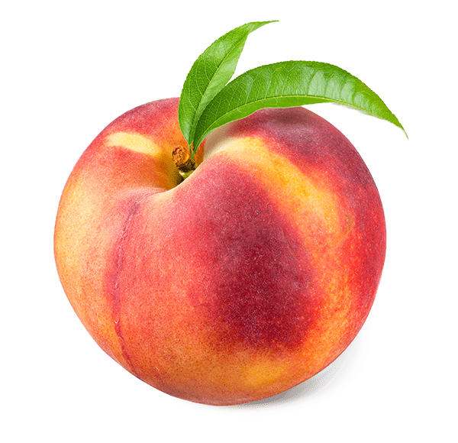
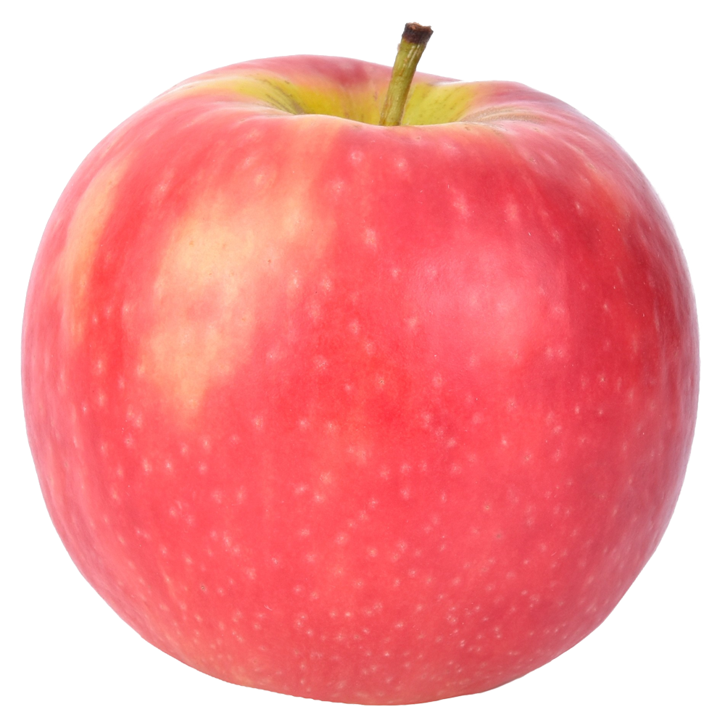
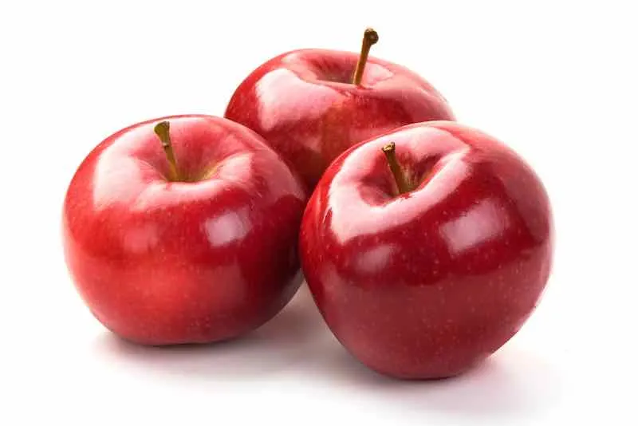
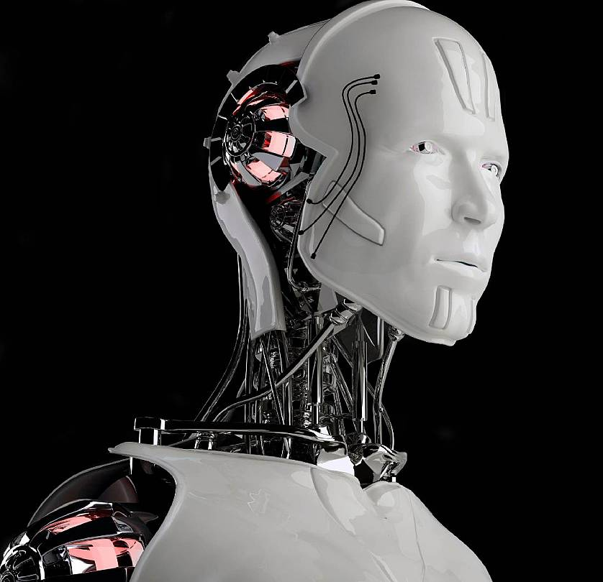
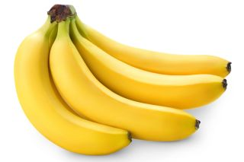
Supervised Learning
Classification problem
Apple
Apple
Apple
Output
Model
(Algorithm)
Banana
Input
Oybek Eraliev

Slide 9
Supervised Learning
Regression problem
45 °C
Temperature (°C) | Temperature (F)
10 | 50
13 | 55.4
22 | 71.6
35 | 95
113 F
Input
Model
(Algorithm)
Output
Oybek Eraliev

Slide 10
Content
What is Machine Learning?
Supervised Learning
Unsupervised Learning
Linear Regression with One Variable
Linear Regression with Multiple Variables

Slide 11
Unsupervised Learning
Clustering problem
K – Means
MeanShift
Unsupervised learning
Dimensionality reduction
Principle Component Analysis (PCA)
Linear Discriminant Analysis (LDA)
Autoencoders (AEs)
Oybek Eraliev

Slide 12
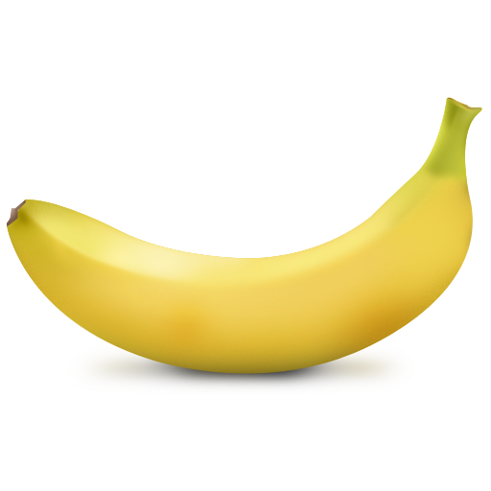
Unsupervised Learning
Clustering problem
Input
Model
(Algorithm)
Output
Oybek Eraliev

Slide 13
Content
What is Machine Learning?
Supervised Learning
Unsupervised Learning
Linear Regression with One Variable
Linear Regression with Multiple Variables

Slide 14
100
Dataset
95
95
90
80
Temp (°C)
Temp (F)
70
Temp (°C) (x) | Temp (F) (y)
10 | 50
15 | 59
20 | 68
25 | 77
30 | 86
35 | ?
x
y
60
10
50
50
15
59
20
68
25
77
30
86
35
F = 32 + 1.8·t
Oybek Eraliev

Slide 15
800
700
600
Prices
500
Houses prices
(Dataset)
300
200
Size (feet²),
(x)
Prices (in 1000 of $)
(y)
x
y
500
1000
1500
2000
2500
3000
3500
2104
460
Size (feet²)
1416
232
1534
315
852
178
…
…
Oybek Eraliev

Slide 16
Temp (C°), (x)
Temp F (y)
10
50
1
10
50
15
59
Training set of
Temp. Dataset
2
15
59
20
68
m
3
x
20
y
68
4
25
77
…
…
…
x = “input” variable/feature
(x⁽¹⁾, y⁽¹⁾) = ( , )
y = “output” variable/target
m = Number of training examples
(x⁽²⁾, y⁽²⁾) = ( , )
(x, y) – one training example
(x^{(i)}, y^{(i)}) – i th training example
(x⁽³⁾, y⁽³⁾) = ( , )
Oybek Eraliev

Slide 17
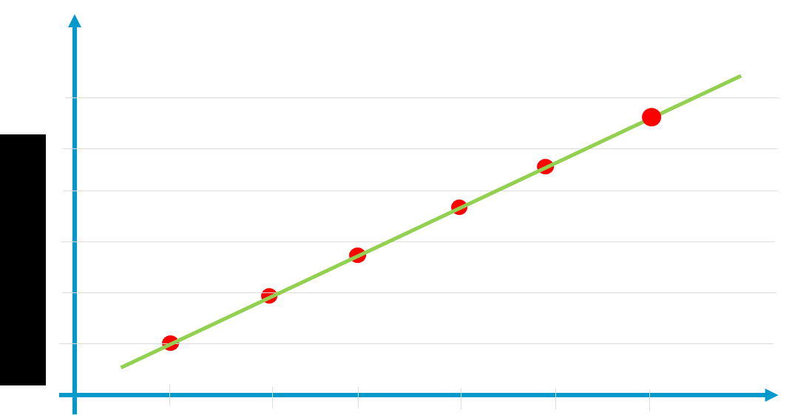
Training Set
How do we represent h?
h_{θ}(x) = θ₀ + θ₁x
y = b + wx
y
Learning Algorithm
Temp
(C°)
h
Temp
(F)
h_{θ}(x) = θ₀ + θ₁x
x
Hypothesis
F
32
1.8
t
F = 32 + 1.8·t
y = h_{θ}(x) =
θ₁ = w =
θ₀ = b =
x =
Linear Regression with one variable
Oybek Eraliev

Slide 18
Hypothesis: h_{θ}(x) = θ₀ + θ₁ x
Temp (C°), (x)
Temp F (y)
Temperature Dataset
10
50
h(x) = 1.5 + 0·x
1
10
50
h(x) = 0 + 0.5 · x
h(x) = 1 + 0.5 · x
h_{θ}(x)
h_{θ}(x)
h_{θ}(x)
15
59
2
15
59
3
3
20
3
68
m = 50
3
20
68
2
2
4
25
2
77
1
1
…
…
1
…
x
x
x
0
1
2
3
0
1
2
3
0
1
2
3
Hypothesis: h_{θ}(x) = θ₀ + θ₁ x
Hypothesis: h_{θ}(x) = θ₀ + θ₁ x
θ₀ = 1.5
θ_{i} : Parameters
θ₀ = 0
θ₀ = 1
θ₁ = 0
θ₁ = 0.5
θ₁ = 0.5
Oybek Eraliev

Slide 19
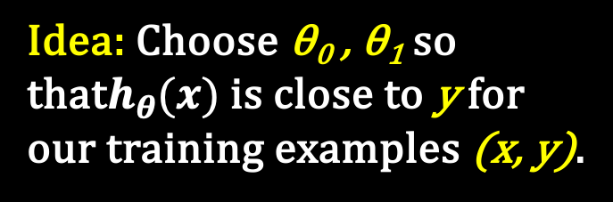
(x^{(i)}, y^{(i)})
$$\sum_{i=1}^{m}{ }$$
$$\frac{1}{2m}$$
$$\sum_{i=1}^{m}{ }$$
$$\frac{1}{2m}$$
$${\left(h_{\text{θ}}(x^{\left(i\right)}) − y^{(i)}\right)}^{2}$$
$$\underset{\text{θ}\text{0}\text{ , }\text{θ}\text{1}}{minimize}{ }$$
$${\left(h_{\text{θ}}(x^{\left(i\right)}) − y^{(i)}\right)}^{2}$$
$$\underset{\text{θ}\text{0}\text{ , }\text{θ}\text{1}}{minimize}{ }$$
y
θ₀ , θ₁
$$h_{\text{θ}}\left(x^{\left(i\right)}\right)= {\text{θ}}_{0}+ {\text{θ}}_{1}x^{(i)}$$
0
x
Cost
function
$$J\left({\text{θ}}_{0},{\text{θ}}_{1}\right)$$
$$J\left({\text{θ}}_{0},{\text{θ}}_{1}\right)=$$
Idea: Choose θ₀ , θ₁ so that$h_{θ}(x)$ is close to y for our training examples (x, y).
Squared error function
Oybek Eraliev

Slide 20









Hypothesis:
Simplified:
h_{θ}(x) =
h_{θ}(x) = θ₀ + θ₁ x
θ₀
θ₁ x
= 0
Parameters:
θ₁
θ₀ , θ₁
Cost function:
$$\sum_{i=1}^{m}{ }$$
$$\frac{1}{2m}$$
$$\sum_{i=1}^{m}{ }$$
$$\frac{1}{2m}$$
$${\left(h_{\text{θ}}(x^{\left(i\right)}) − y^{(i)}\right)}^{2}$$
$$J\left({\text{θ}}_{0},{\text{θ}}_{1}\right)=$$
$${\left(h_{\text{θ}}(x^{\left(i\right)}) − y^{(i)}\right)}^{2}$$
$$J\left({\text{θ}}_{1}\right)=$$
Goal:
$$\underset{\text{θ}\text{1}}{minimize}{ }$$
$$\underset{\text{θ}\text{0}\text{ , }\text{θ}\text{1}}{minimize}{ }$$
$$J\left({\text{θ}}_{0},{\text{θ}}_{1}\right)$$
$$J\left({\text{θ}}_{1}\right)$$
Oybek Eraliev

Slide 21






















h_{θ}(x)
$$J\left({\text{θ}}_{1}\right)$$
h_{θ}(x)= θ₁ x
${\text{θ}}_{1}$=1
$$J\left({\text{θ}}_{1}\right)$$
3
×
h_{θ}(x)= θ₁ x
3
y
2
×
${\text{θ}}_{1}$=0.5
×
×
2
1
×
h_{θ}(x)= θ₁ x
1
${\text{θ}}_{1}$=0
×
×
0
1
2
3
×
$${\text{θ}}_{1}$$
x
0.5
0
0.5
1
1.5
2
2.5
$$\frac{1}{2m}$$
$$\sum_{i=1}^{m}{ }$$
$$J\left({\text{θ}}_{1}\right)=$$
$${\left(h_{\text{θ}}(x^{\left(i\right)}) − y^{(i)}\right)}^{2}$$
$$\frac{1}{2m}$$
$$\frac{1}{2·3}$$
$${\text{θ}}_{1}$$
1
0.5
0
1.5
${(\left(1 −1\right)}^{2}$+ ${\left(2 −2\right)}^{2}$+ ${\left(3 −3\right)}^{2})$
2
$$J\left(1\right)=$$
$$=$$
· 0 = 0
$$\frac{1}{2m}$$
$$\frac{1}{2·3}$$
$$J\left({\text{θ}}_{1}\right)$$
0
0.58
2.33
0.58
2.33
${(\left(0.5 −1\right)}^{2}$+ ${\left(1 −2\right)}^{2}$+ ${\left(1.5 −3\right)}^{2})$
$$J\left(0.5\right)=$$
$$=$$
· 3.5 = 0.58
$$\frac{1}{2m}$$
$$=$$
$$\frac{1}{2·3}$$
$$\underset{\text{θ}\text{1}}{minimize}{ }$$
$$J\left({\text{θ}}_{1}\right)$$
${(\left(0 −1\right)}^{2}$+ ${\left(0 −2\right)}^{2}$+ ${\left(0 −3\right)}^{2})$
$$J\left(0\right)=$$
· 14 = 2.33
Oybek Eraliev

Slide 22








$$\frac{1}{2m}$$
$$\sum_{i=1}^{m}{ }$$
Cost function:
$$J\left({\text{θ}}_{0},{\text{θ}}_{1}\right)=$$
$${\left(h_{\text{θ}}(x^{\left(i\right)}) − y^{(i)}\right)}^{2}$$
Goal:
$$\underset{\text{θ}\text{0}\text{ , }\text{θ}\text{1}}{minimize}{ }$$
$$J\left({\text{θ}}_{0},{\text{θ}}_{1}\right)$$
Outline:
Start with some ( θ₀ , θ₁ )
$$θ_{0}=0,θ_{1}=0$$
Keep changing θ₀ , θ₁ to reduce $J\left({\text{θ}}_{0},{\text{θ}}_{1}\right)$ until we hopefully end up at a minimum.
Oybek Eraliev

Slide 23
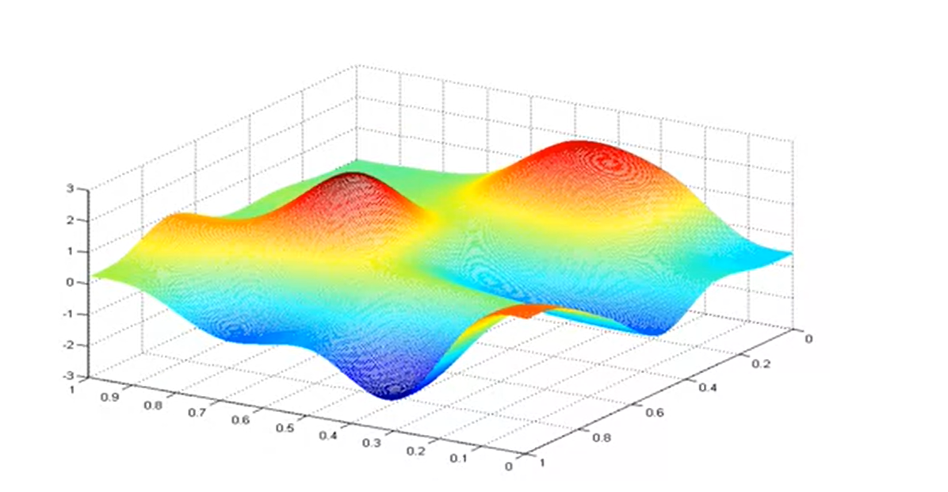



Source: Machine learning course (Andrew Ng)
$$J\left({\text{θ}}_{0},{\text{θ}}_{1}\right)$$
$${\text{θ}}_{1}$$
$${\text{θ}}_{0}$$

Slide 24




Gradient descent algorithm
Repeat until convergence {
$θ_{j}$ = $θ_{j}−$ $α∙\frac{∂}{{∂θ}_{j}}J(θ_{0},θ_{1})$ (for j = 0 and j = 1)
}
Learning rate
Derivative part
$$\underset{\text{θ}\text{1}}{minimize}{ }$$
$$J\left({\text{θ}}_{1}\right)$$
$\text{θ}\text{1}$ $∈R$
Oybek Eraliev

Slide 25












$$J\left({\text{θ}}_{1}\right)$$
$$Positive slope$$
$θ_{1}$ = $θ_{1}−$ $α∙\frac{∂}{{∂θ}_{1}}J(θ_{1})$
$$≥0$$
$θ_{1}$ = $θ_{1}−$ $α∙(Positive value)$
$${\text{θ}}_{1}$$
$$J\left({\text{θ}}_{1}\right)$$
$$Negative slope$$
$θ_{1}$ = $θ_{1}−$ $α∙\frac{∂}{{∂θ}_{1}}J(θ_{1})$
$$≤0$$
$θ_{1}$ = $θ_{1}−$ $α∙(Negative value)$
$${\text{θ}}_{1}$$
Oybek Eraliev

Slide 26






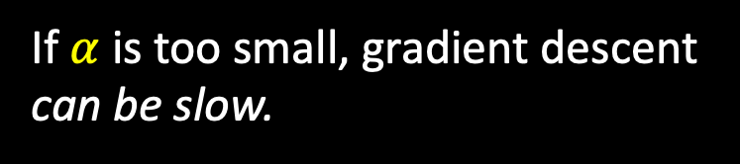
$$J\left({\text{θ}}_{1}\right)$$
$θ_{1}$ = $θ_{1}−$ $α∙\frac{∂}{{∂θ}_{1}}J(θ_{1})$
If $α$is too small, gradient descent can be slow.
0
$${\text{θ}}_{1}$$
$$J\left({\text{θ}}_{1}\right)$$
If $α$is too large, gradient descent can overshoot the minimum. It may fail to converge, or even diverge.
0
$${\text{θ}}_{1}$$
Oybek Eraliev

Slide 27









$$J\left({\text{θ}}_{1}\right)$$
$$slope=0$$
$${\text{θ}}_{1} at local optima$$
$${\text{θ}}_{1}$$
$θ_{1}$ = $θ_{1}−$ $α∙\frac{∂}{{∂θ}_{1}}J(θ_{1})$
$$Current value of{\text{θ}}_{1}$$
$$=0$$
$θ_{1}$ = $θ_{1}−$ $α∙0$
$θ_{1}$ = $θ_{1}$
Oybek Eraliev

Slide 28






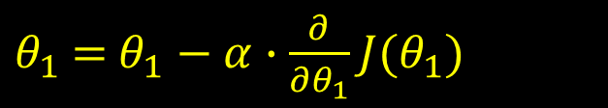
Gradient descent can converge to a local minimum, even with the learning rate $α$fixed.
$$J\left({\text{θ}}_{1}\right)$$
$$a$$
$θ_{1}$ = $θ_{1}−$ $α∙\frac{∂}{{∂θ}_{1}}J(θ_{1})$
$$b$$
As we approach a local minimum, gradient descent will automatically take a smaller steps. So, no need to decrease $α$ over time.
0
$${\text{θ}}_{1}$$
Oybek Eraliev

Slide 29


Temperature
(Dataset)
h_{θ}(x)= θ₀ + θ₁ x
$$y$$
100
Temp (°C)
Temp (F)
Temp (°C) (x) | Temp (F) (y)
10 | 50
15 | 59
20 | 68
25 | 77
30 | 86
x
y
90
80
70
60
50
$$x$$
10
15
20
25
30
F = 32 + 1.8·t
h_{θ}(x)= 32 + 1.8 · x
θ₀ = 32
θ₁ = 1.8
Oybek Eraliev

Slide 30






























Gradient descent algorithm
Linear Regression Model
Repeat until convergence {
(for j = 0 and j = 1)
}
h_{θ}(x)= θ₀ + θ₁ x
$$\sum_{i=1}^{m}{ }$$
$θ_{j}$ = $θ_{j}−$ $α∙\frac{∂}{{∂θ}_{j}}J(θ_{0},θ_{1})$
$$\frac{1}{2m}$$
$$\sum_{i=1}^{m}{ }$$
$$\frac{1}{2m}$$
$${\left(h_{\text{θ}}(x^{\left(i\right)}) − y^{(i)}\right)}^{2}$$
$$J\left({\text{θ}}_{0},{\text{θ}}_{1}\right)=$$
$${\left(h_{\text{θ}}(x^{\left(i\right)}) − y^{(i)}\right)}^{2}$$
$$\underset{θ_{0},θ_{1}}{minimize}{ }$$
$$J(θ_{0},θ_{1})$$
$$\frac{∂}{{∂θ}_{j}}$$
$$\sum_{i=1}^{m}{ }$$
$$\frac{∂}{{∂θ}_{j}}$$
$$\frac{1}{2m}$$
$$\sum_{i=1}^{m}{ }$$
$\frac{∂}{{∂θ}_{j}}J(θ_{0},θ_{1})$
$$\frac{1}{2m}$$
$${\left(h_{\text{θ}}(x^{\left(i\right)}) − y^{(i)}\right)}^{2}$$
$$=$$
$${\left(\text{θ}\text{0}\text{ + }\text{θ}\text{1}x^{\left(i\right)} − y^{(i)}\right)}^{2}$$
$$=$$
$$\frac{1}{m}$$
$$\sum_{i=1}^{m}{ }$$
$\frac{∂}{{∂θ}_{0}}J(θ_{0},θ_{1})$
$$θ_{0}$$
j = 0
$$=$$
$${\left(h_{\text{θ}}(x^{\left(i\right)}) − y^{(i)}\right)}^{ }$$
$$\frac{1}{m}$$
$$\sum_{i=1}^{m}{ }$$
$\frac{∂}{{∂θ}_{1}}J(θ_{0},θ_{1})$
$$θ_{1}$$
j = 1
$$=$$
$${\left(h_{\text{θ}}(x^{\left(i\right)}) − y^{(i)}\right)·x^{\left(i\right)}}^{ }$$
Oybek Eraliev

Slide 31
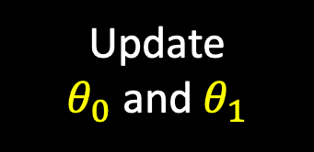






Gradient descent algorithm
Repeat until convergence {
(for j = 0 and j = 1)
}
$$\sum_{i=1}^{m}{ }$$
$θ_{0}$ = $θ_{0}−$ $α∙\frac{1}{m}$
$${\left(h_{\text{θ}}(x^{\left(i\right)}) − y^{(i)}\right)}^{ }$$
Update
$θ_{0}$ and $θ_{1}$
$$\sum_{i=1}^{m}{ }$$
$θ_{1}$ = $θ_{1}−$ $α∙\frac{1}{m}$
$${\left(h_{\text{θ}}(x^{\left(i\right)}) − y^{(i)}\right)∙x^{\left(i\right)}}^{ }$$
Oybek Eraliev

Slide 32
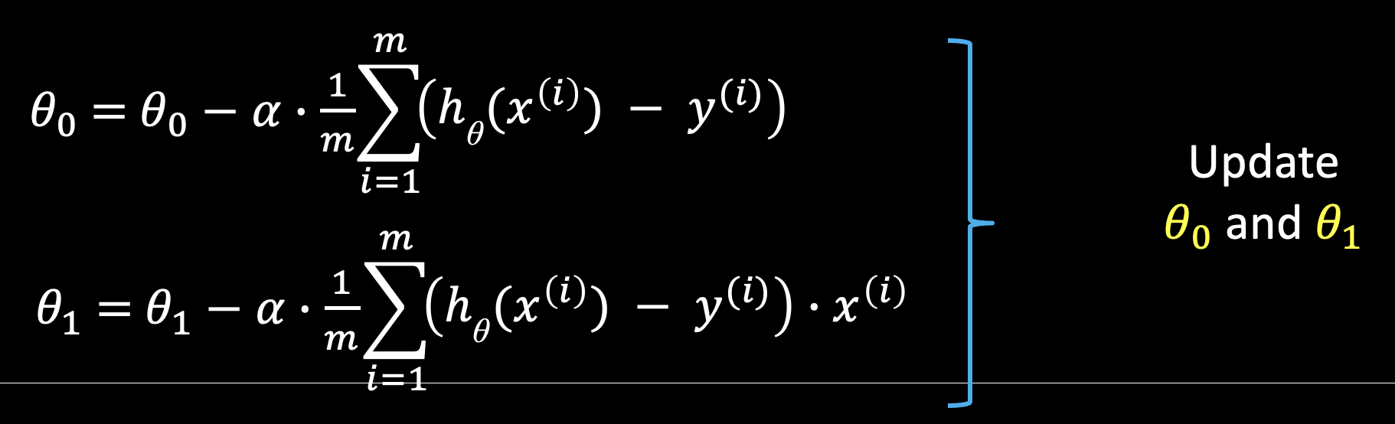












h_{θ}(x)
$J(θ_{0},θ_{1})$
$$y$$
100
5.
$$J\left({\text{θ}}_{1}\right)$$
90
4.
80
1.
70
3.
2.
60
2.
50
5.
3.
4.
$$x$$
1.
10
15
20
25
30
0
$${\text{θ}}_{1}$$
Iterations:
Cost function:
Gradient descent:
1. ${\text{θ}}_{0}$ = 0$, {\text{θ}}_{1}$ = 0
2. ${\text{θ}}_{0}$ = …, ${\text{θ}}_{1}$ = …
$$\sum_{i=1}^{m}{ }$$
3. ${\text{θ}}_{0}$ = …, ${\text{θ}}_{1}$ = …
$$J\left({\text{θ}}_{0},{\text{θ}}_{1}\right)=$$
$$\frac{1}{2m}$$
$${\left(h_{\text{θ}}(x^{\left(i\right)}) − y^{(i)}\right)}^{2}$$
4. ${\text{θ}}_{0}$ = …, ${\text{θ}}_{1}$ = …
5. ${\text{θ}}_{0}$ = 32, ${\text{θ}}_{1}$ = 1.8
$$α=0.01$$
Oybek Eraliev

Slide 33


Slide 34


